Slide 1
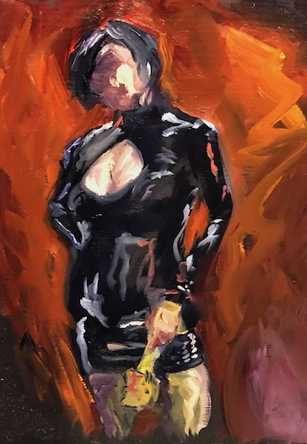
Quarantine Scene Workshop: negotiating and creating hotter online play
MxBliss w/ special guest BeyondModernMatt
For RopeCraft HomeBound 2020

Slide 2
What we we’ll cover
Consent in the Age of COVID
Online Play: What is it? How is it different?
Enhancing the connection through communication/props/toys
Negotiation
Demo a negotiation and scene
Try it on your own
The wisdom of the Online Room
Q&A
[If time allows] Demo another mini scene

Slide 3
Consent in the Age of COVID
Enthusiastic & Informed Consent
PLUS
RAVE—Risk Aware Virus Exposure
  We are equipped with all the tools to have these discussions
  Look at the data and make risk aware decisions based on concentric circles of risk
  Informed consent—think of the STI conversations you have
Electronic consent, privacy, and physical safety

Slide 4
Online Play: What is it?
Online Play is what happens with kinky sexnerds leverage technology to have real time connection when they can’t be in the physical space
Examples:
Partners across town who engage in regular sexting
Cam play
Porn…yeah…porn
Long distance D/s
A scene during on an online play party or a private play session. Elements:
  2 or more play partners
  A negotiation (and I'll talk more about that later)
  Video cameras and way to videochat like FaceTime, Signal, or Zoom. For the dirtier stuff, I recommend Signal as it has end to end encryption.
  And toys/props

Slide 5
It ain’t the same, but you can make it hotter
What’s missing?
How can you make it hotter?
Proximity—flesh on flesh
Physical touch of another
Smell
3-D
Snuggles
Focus on voice commands and visual stimulation
Expand your topping skills so you can ‘do the things’ to yourself
Find ways to stimulate sense of smell (send clothes, perfumes, cooking smells)
Multiple camera angles/close ups
Stuffies, onsies, blankies, comfort foods
Remote controlled toys
Notes:
Rope as an analogy
Demo Lovense

Slide 6
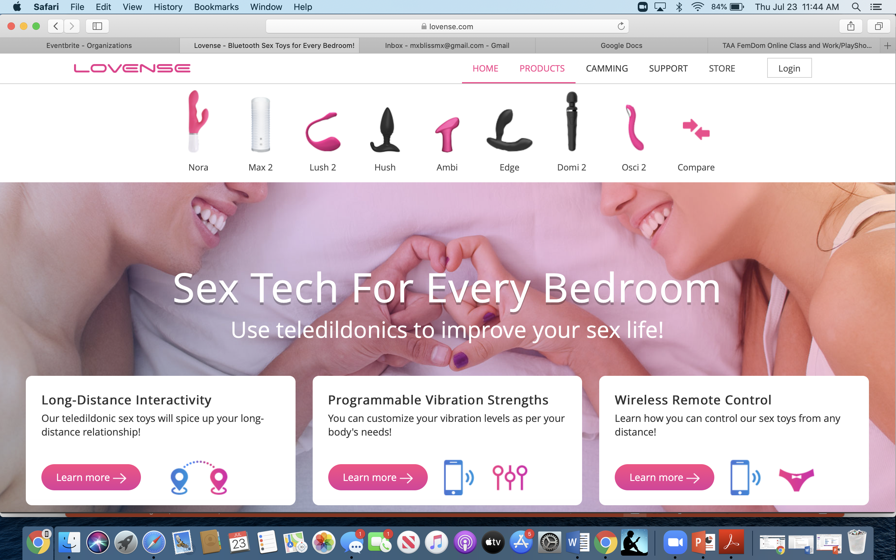

Slide 7
Lean into the ways in which it is already hotter…
Conditioned for porn—visual versus other types of stimulation
Enhance the feelings of ‘being desired’ and objectified through your words
Constraints can make it easier and more focused
Remote locations make for more interesting location possibilities
  Natural environments
  Service rituals
For folks unsure about Domination/Topping, this is a GREAT opportunity to gain confidence
Fetishes and kinks take conditioning…this will take time and practice…and then you will want more
SUPER HOT (as a D-type) to make people do things to themselves—hot, hot, power/energy exchange

Slide 8
What is a BDSM negotiation for Online Play?
Outlining the elements of a scene/relationship
A list of the ‘things’ on the table based on resources/skills available on site
Asking for what you want & listening to what your partner wants/doesn’t want
Communicating limits
A wonderful way to connect
It’s NOT consent to play
The goal of ANY BDSM negotiation is informed consent grounded in inquiry
leading to HOTTER EXPERIENCES
Notes:
Ask room what BDSM Negotiation is…
Consent to talk, do not mistake it with consent to play…it’s a screening mechanism, and if you are doing it right, you are NOT playing with a significant portion of people you might engage in negotiation with.
Finally, Negotiation in Vanilla or kink is not about I win and you lose (or vice versa). It’s quite rarely a zero sum game. Instead it is about finding black swans and finding ways in which our playing together multiplies joy within the constraint.

Slide 9
Notes:
In the end, the way we have memorable scenes and wonderful relationships is by making one another feel good. So when thinking about a kink Negotiation, I always start with how I want my partner to feel and whether it aligns with the way I want to feel.

Slide 10
Negotiation Tip: Focus on Interests*
Play is about connecting through sensation/emotion/experiences
Focus on the way you and your partner want to feel not ‘the things’
What matters is why? All the ‘things’ are in service to the interest or feelings you want to evoke
What is it that you want to feel?
  Why do you want to play? Why with me?
  Most of us haven’t been asked to articulate this before
How do you want to FEEL during and after our scene?
Notes:
If you walk away with one thing today, it’s that in negotiation in kink or vanilla, the key to unlocking more value, greater joy, optimized results, hotter fucking…is to understand the interests and values of your partner and to convey yours.
Tell the orange story—
There are usually several different ways to satisfy an interest and you can optimize outcomes for each.
CLICK→SO, the most important value creation question in kink is: How do you want to feel during and after our scene?

Slide 11
Interests?
Interests/Goals (e.g.)
The Feelings (e.g.)
  Sharing intimacy
  Caring for me/my partner
  Repeat play
  Relaxing
  Safety
  Sexy time
  Subspace/Topspace
  Experiencing something transformative
  Connected/Loved
  Adored/Desired
  Powerful, powerless
  Owned, Owning
  Empowered
  Energized
  ‘I want to forget’
  Horrified, degraded, humiliated, objectified

Slide 12
Negotiation Tip: Ask (don’t guess)
What does your body do when you’re having a great time? What does your body do when you are having a shit time? How can I tell via video/phone?
What turns you on? What are your turnoffs?
Do you have physical injuries or emotional traumas that are relevant
to our scope of play?
Aftercare: What kind of aftercare would you like given our location constraints?
Is sexy-time on the table? If yes, what? Penetration? Where? What?
Notes:
Of course the interest and feelings of a scene are driven in large part by your partners.
With some partners, I want to feel powerful and large. With other partners, I want to feel small and objectified. In all cases, I want to feel adored and sexy. And so much of what I want depends on who. And if I don’t know who I’m playing with, its hard to establish what possibilities are out there.
As some of you may know, I have a fetish for spreadsheets. If I’m scening with an artist, the likelihood that she will whip out a pivot table are slim. But if its an artist, maybe calligraphy on my body could be an element of the scene if I want to be objectified.
We show up at these clubs or play parties in our Fet costumes but we are people with motivations, interests, histories, and experiences. Knowing some of that will allow you to be a much more intimate play partner…and what is BDSM if its not intimacy?

Slide 13
Additional Online Negotiation Inquiries
What kind of toys, costumes, equipment are at your disposal?
What topping skills does the bottom have?
How will we manages online privacy? Recordings? Photos? Screen Shares?
Who will be around during our play? For safety? Interruptions? Privacy/Consent?

Slide 14
Demo
About consent & prenegotiation
Activation/Trigger Warning

Slide 15
Your Turn
Breakouts—how it will work
What to practice & how:
  How do you want to feel during and after our scene?
  Successories: What does, clothes, costumers, and equipment/furniture do you have on site we could use for our scene?
  How can I tell whether you are having a great time? How can I tell whether you are having a shit time?
When we come back, will share insights and ideas for online play

Slide 16
Ideas for Online Scenes (from the class)
Service rituals (bootblacking, food delivery, Googledrive)
Rope scene with a rope bottom that has some basic knot or self tie skills
On ongoing long distance D/s relationship and microplay in the form of protocols
An impact scene with toys at the bottom’s disposal
CBT
Mutual masturbation
Exhibitionist/humiliation play leveraging face masks
Kinky scavenger hunt designed to frustrate and/or delight your bottoms
Fantasy/Role Play
Fitness/Wellness Domination w/ Proof of Performance
Send a naughty picture at work
Using a tense unit
Body Writing
Chastity/edging/Orgasm Control/Denial—denial until online
Wax play
Directed self tie
Partner dancing with a big pillow

Slide 17
Questions/Resources
STARS (let’s talk about sex)
STARS Resources
Mx Bliss' Negotiation Worksheets
Scene Negotiation Worksheet
Online Play Worksheet
Lovense (Teledildonic Toys)
www.lovense.com

